Slide 1
Software Engineering and Architecture
Frameworks

Slide 2
Motivation
I have presented some design principles
3-1-2 process: encapsulate variation, program to an interface and compose behavior using delegation
Compositional design // SOLID principles
it is better to reuse code by delegation than inheritance
Smaller, cohesive roles collaborating is better than a big blob
Iterative and Incremental search for variability
supported by TDD
supported by refactoring
... and on the way we discovered some patterns

Slide 3
Abstracting
[GoF]
What I have actually done is to show you the pieces that together form the puzzle called frameworks:
Framework:
A framework is a set of cooperating classes that make up a reusable design for a specific class of software.
Exercise:
Is the pay station a framework given this definition?
Argue why MiniDraw is a framework.

Slide 4
Framework Characteristics
A framework is characterized by
reuse of both design as well as executable code
reuse within a well defined domain
Java Swing is for GUI’s, not for banking…
high reuse percentage (70-90%)
must be customized for customer’s particular need
Examples:
Eclipse & IntelliJ IDE and Gradle plug-in architecture
Android / IOS
Web server frameworks (Jetty, Spark-Java, …)
HTML DOM and JavaScript
… MiniDraw

Slide 5
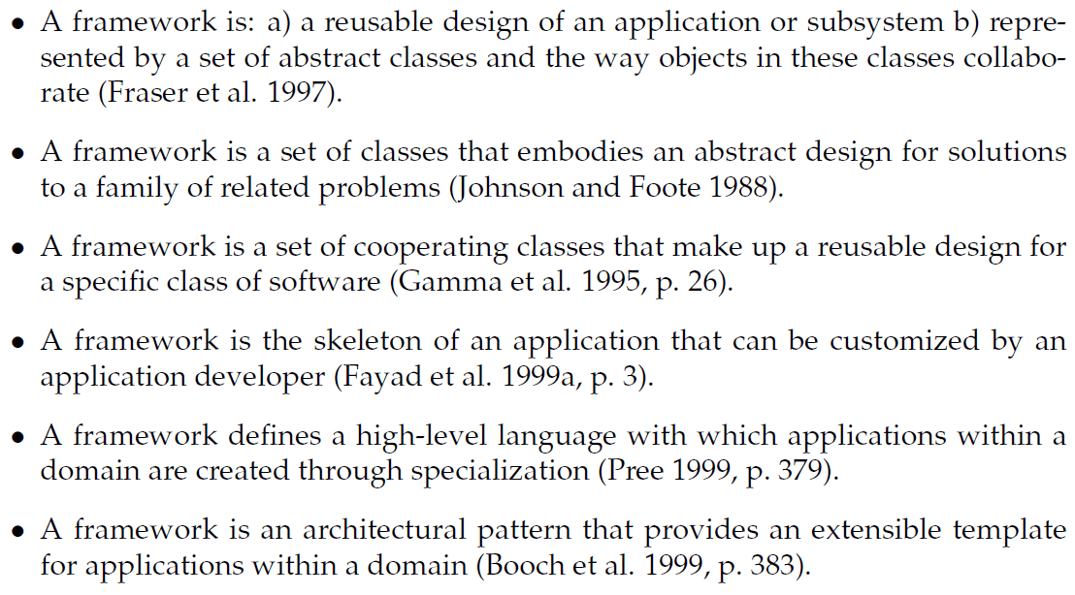
Other Definitions

Slide 6
Common aspects
Skeleton / design / high-level language
… provide behavior on high level of abstraction: a design/skeleton/architecture
Application/class of software
… has a well defined domain where it provides behavior
Cooperating / collaborating classes
… define and limit interaction patterns (protocol) between well defined roles
Customize/abstract classes/reusable/specialize
… can be tailored to a concrete context
Classes/implementation/skeleton
... is reuse of code as well as reuse of design

Slide 7
Variability points = Hotspots

Slide 8
Applications from frameworks
A framework based application is composed of three portions of code
The framework code (external, third party)
The framework customization code (our own ‘tailoring’ code)
Non-framework related code (own domain code)
Example: HotStone project
MiniDraw framework (basic 2D GUI control)
Customization code (adapt MiniDraw til HotStone graphics)
HotStone domain code (card draw, attacking, …)

Slide 9
Which leads to...
Traditionally one distinguish between
Developers: Developing the software for end users
End users: Using the software
Frameworks require one additional role
Framework developers: Develops the framework
Application developers: Adapt the FW for users
End users: Using the software
I.e.: The end users of a framework are themselves software developers!

Slide 10
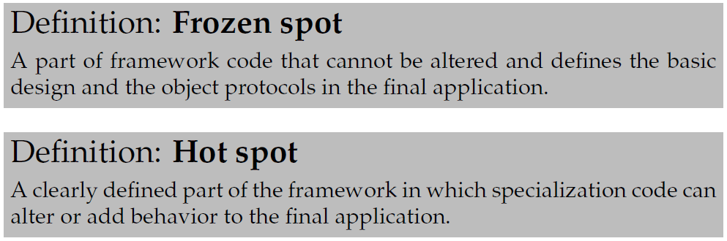
HotSpots…
”Separate code that changes from
the code that doesn’t”
Hot spots are also known as:
Hooks / hook methods / callback functions
Variability points (our favorite term)

Slide 11
Example
The pay station system has hotspots regarding
receipt type
rate policy
display output
weekend determination
but frozen spots, fixed behavior, concerning
coin types (payment options), numerical only display, only buy and cancel buttons, etc.
Domain: Pay stations
no reuse in the electronic warfare domain ☺

Slide 12
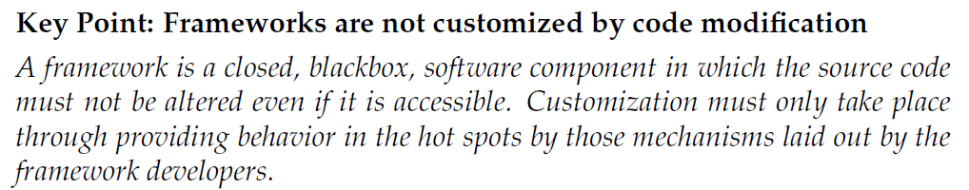
Frozen spots
Frozen is important : keep the code in the fridge!
Code modifications means unthawing and freezing again   

Slide 13
Why...
I have realized that this point is so natural to me that I in early teaching simply has forgotten to emphasize it.
Why
Consider Java Swing
If you had to rewrite code in 8 different places in the Swing library to add a new special purpose visual component
Then you had to
Understand the Swing code in deep detail (costs!)
Reintroduce special purpose code every time Sun/Oracle releases a new version of Swing (costs!!!)
Thus, I can get the Swing source code but I should still not change it!

Slide 14

Even More Why…
Most of the time – you are of course not allowed to change the code !
Apple iOS
Is closed-source so you can of course not in any way change that
And if you could, all iPhone users had to install your version of iOS on their phone to use your great app… That is not feasible, right?

Slide 15
Morale
You adapt a framework to your particular needs by
Change by addition, not by modification!!!
Open for extension, closed for modification
You
Implement interfaces or extend existing classes
Concrete implementations, real behavior filling out the responsibilities defined by the framework
Tell the framework to use your implementations...

Slide 16
Which again leads to...
If the framework has to use my concrete implementations then...
It cannot itself create these objects
If MiniDraw itself defined
Drawing drawing = new CompositionalDrawing();
Then it was an application (fixed behavior), not a framework (adaptable behavior).
Then ... How can it create objects?

Slide 17
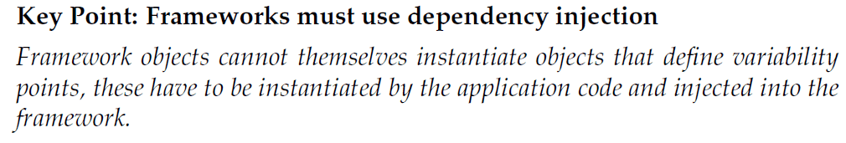

Dependency Injection
Typically an (OO) framework would use factory techniques like abstract factory
Or prototype or factory method patterns...
Or reading configuration files, or using conventions
Ruby on Rails, Grails, Maven, IntelliJ, Eclipse, use particular named files in specific directory paths to configure the frameworks
Or – by inheritance based techniques…
Android OS, LibGdx, and many others…

Slide 18
Customization Techniques

Slide 19
Techniques to define hotspots
We have object oriented composition to define hotspots. We have also looked at other techniques
Parameterization, overriding superclass methods
Notes:
Jump tables in assembler, function pointers in C, higher order functions in functional languages, procedure parameters in Pascal

Slide 20
HotSpots
Exercise: List techniques to make the hotspots
Hint: Consider techniques used in
MiniDraw
Swing
Collection classes
Eclipse
C library sorting algorithms
Intel i7 interrupt vector handling
Functional languages
Amiga libraries ☺
Does a Framework require object-orientation?

Slide 21
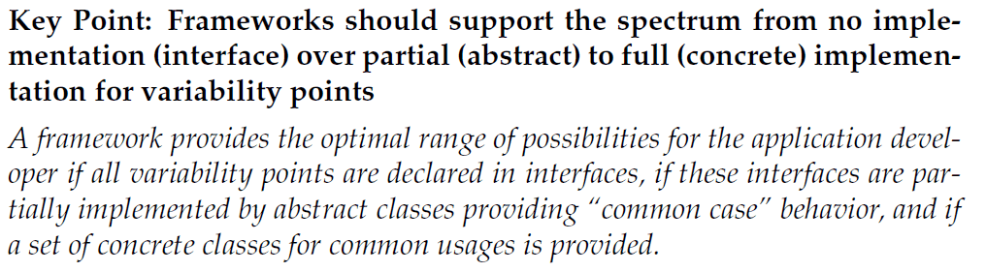
A good framework...
... Must give ”return on investment”
Investment: ”I have to learn how to use it”
Return: ”I get reliable software that does a lot”
Android/Swing/MiniDraw/...
Consider writing the Android OS yourself!

Slide 22
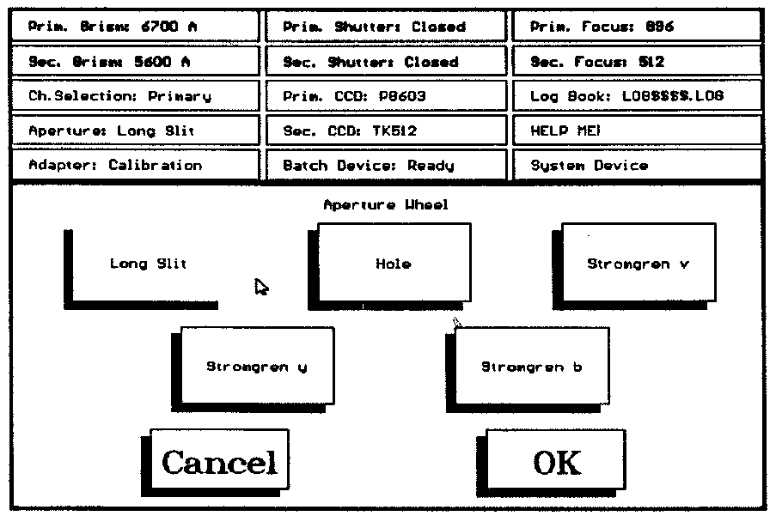
In the old times...
You made the GUI using drawLine !!!
Notes:
... We had to write everything ourselves – even the GUI buttons

Slide 23
Framework Protocol

Slide 24
Design and Code Reuse
“Cooperating / collaborating classes
… define and limit interaction patterns (protocol) between well defined roles”
Frameworks require users (=developers) to understand the interaction patterns between objects in the FW and their own customization objects. That is, understand the protocol.
Ex: Understand the editor↔tool protocol in MiniDraw

Slide 25
Where is the protocol?
So: The framework dictates the protocol!
The question is: How?
Notes:
The

Slide 26
Protocol
The protocol arises because objects in the framework invokes methods on objects that are defined by you.
These methods/functions/procedures that are predefined by the framework to be ‘overridable’ or customizable are the hotspots.
A framework contains frozen code with embedded hotspots where your (unfrozen) code may be called.

Slide 27
Inversion of Control
This property of frameworks is called
Inversion of Control
(”Hollywood principle: do not call us, we will call you.)
The framework dictates the protocol – the customization/hotspot code just has to obey it!
“Do something when you are called”

Slide 28
Compare ‘traditional’ reuse
Another type of reuse of code (more than design) is libraries
I have never written my own cosine or random function – have you?
And a long time since I wrote a collection class, like List<T> ☺
There are lot of libraries of usable behavior out there that does not invert control.

Slide 29
Framework Examples

Slide 30
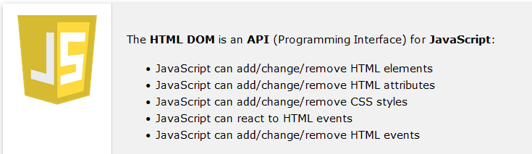
HTML DOM and JavaScript
The “operating system” of browsers
Event-Driven Programming of web pages
The DOM is an object model of the page’s contents
In JavaScript you can associate callback functions with individual elements of that object

Slide 31
DOM and JavaScript
The HTML DOM is a Framework in that each document element can be associated with HotSpots (event listeners). You can define these hotspots by injecting JavaScript functions as callback functions.
The rendering of the DOM is a (lot of) FrozenSpot.

Slide 32
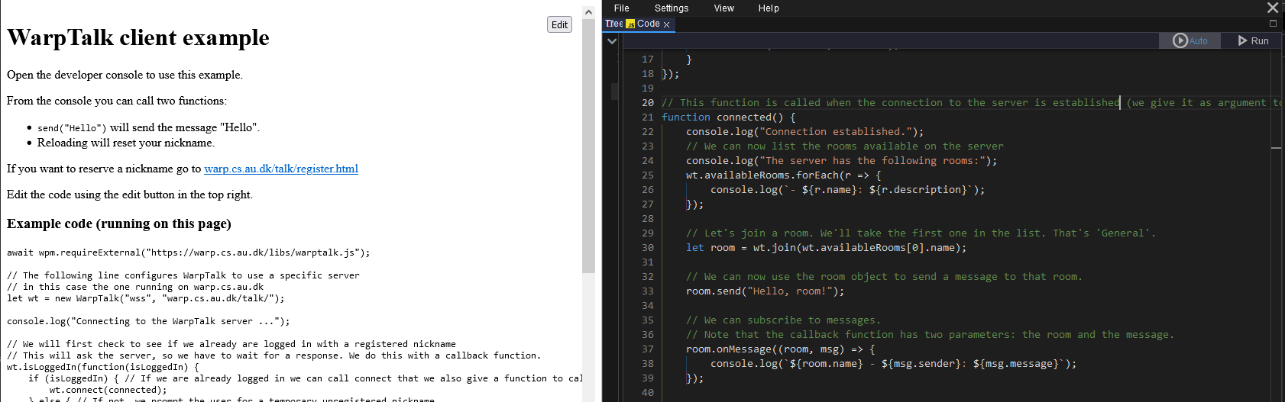
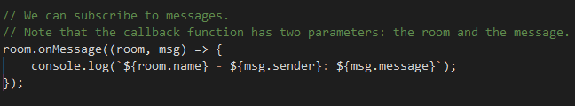
HCI Course
WarpTalk Mandatory Exercise in HCI
Disclaimer: I only spent 5 minutes and have not followed the course, so forgive if I am a bit of here ☺
You fill in the hotspots, like onMessage() which allows you to adapt callback from server…

Slide 33
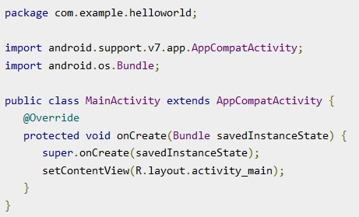
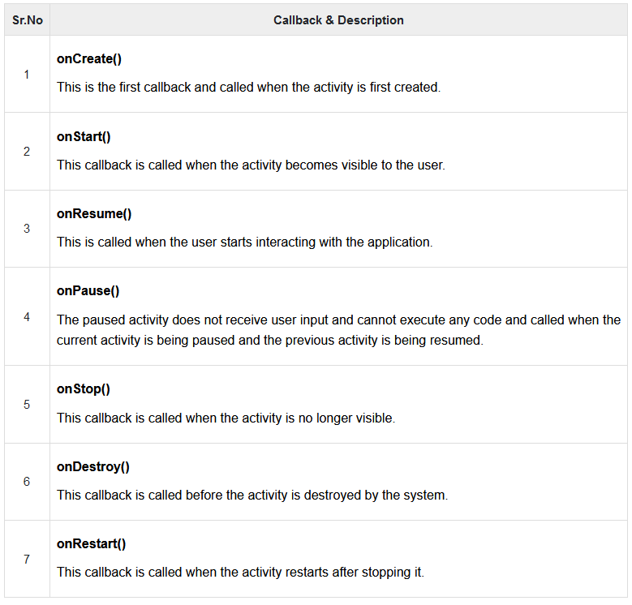
Examples: Android
You do not call AndroidOS – it will call you!

Slide 34
Examples: Android
You do not call AndroidOS – it will call you!

Slide 35
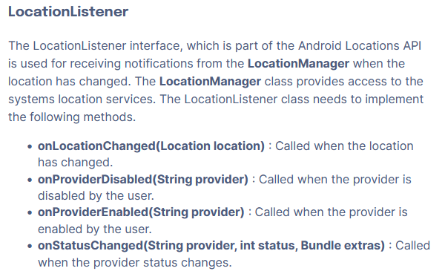
Example: Android GPS
To get continuous tracking of your location, you can add an LocationListener (an Observer role)…

Slide 36
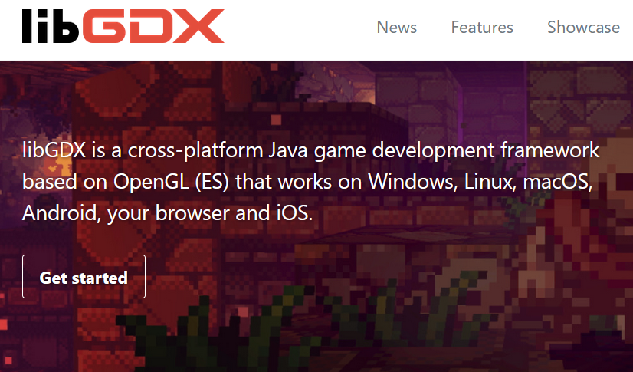

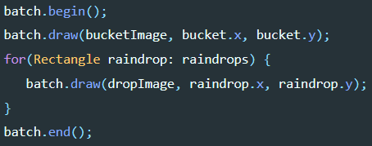
Example: LibGDX
Game Architecture:
loop at ~60 fps
HotSpots for
Rendering, input handling, power management, sprite collisions,

Slide 37
Template Method
The central OO pattern to separate frozen and hot code
The core of the inverted control

Slide 38
Template Method
Intent (Original GoF statement)
Define the skeleton of an algorithm in an operation, deferring some steps to subclasses. Template Method lets subclasses redefine certain steps of an algorithm without changing the algorithm's structure.
Restatement
Some steps in the algorithm are fixed but some steps I would like to keep open for future modifications to the behavior

Slide 39
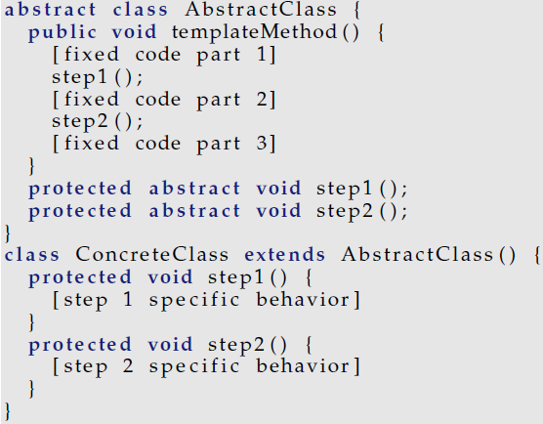
GoF Structure
Not ‘our’ structure…
The structure in GoF is that of subclassing

Slide 40
The Multi-Dimensional Variability
Subclassing handles multi-dimensional variability badly...
Consider
Three variants of step1() required
Four variants of step2()
Any combination feasible
How many subclasses?
Notes:
3*4 = 12

Slide 41
Conclusion
Conclusion:
Favor object composition
over class inheritance

Slide 42
Exercise
Rewrite the GoF structure to its compositional equivalent that is behavioral equivalent but follows the three principles of flexible design.

Slide 43
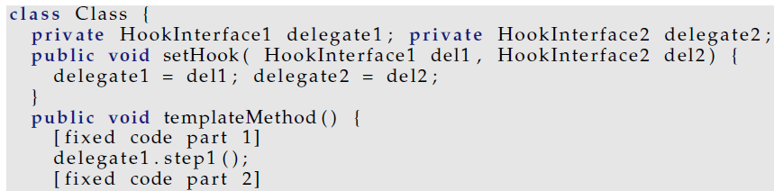
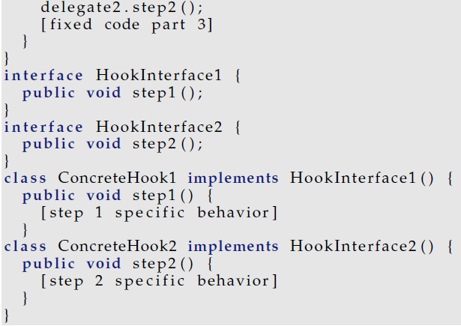
Interface Segregation Principle
The ISP comes in handy
Separate each cohesive (subrole) into its own interface
HookInterface1 and HookInterface2
Improved version:

Slide 44
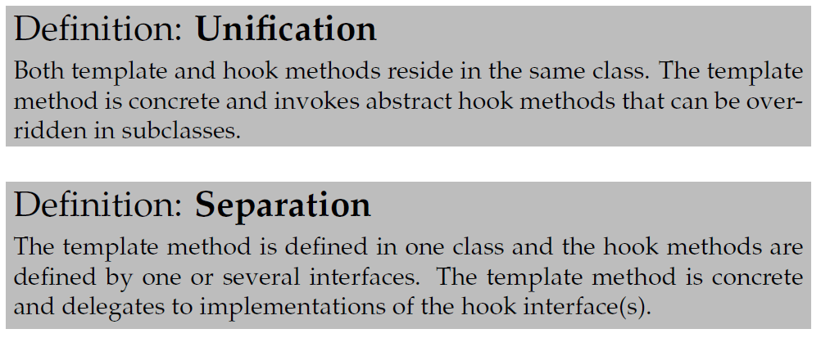
Template Method Terminology
These two variants have a name:
Original: subclassing + override hook methods
New: interface implementation + delegate to hooks

Slide 45
Exercise
public void addPayment( int coinValue ) {
switch ( coinValue ) {
case 5:
case 10:
case 25: break;
default:
throw new IllegalCoinException("Invalid coin: "+coinValue+" cent.");
}
insertedSoFar += coinValue;
_timeBought = rateStrategy.calculateTime(insertedSoFar);
}
Identify template method in the pay station:

Slide 46
Exercise
public void addPayment( int coinValue ) {
switch ( coinValue ) {
case 5:
case 10:
case 25: break;
default:
throw new IllegalCoinException("Invalid coin: "+coinValue+" cent.");
}
insertedSoFar += coinValue;
_timeBought = rateStrategy.calculateTime(insertedSoFar);
}
Frozen code 1
Frozen code 2
Hot code
addPayment is template
A) coin validation; B) accumulation; C) time computation

Slide 47
Exercise
How does template method relate to the inversion of control property of frameworks?

Slide 48
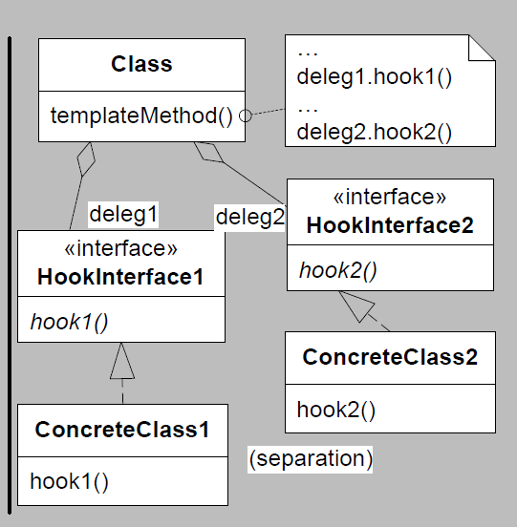
FRS Structure

Slide 49
Another Case for Composition

Slide 50
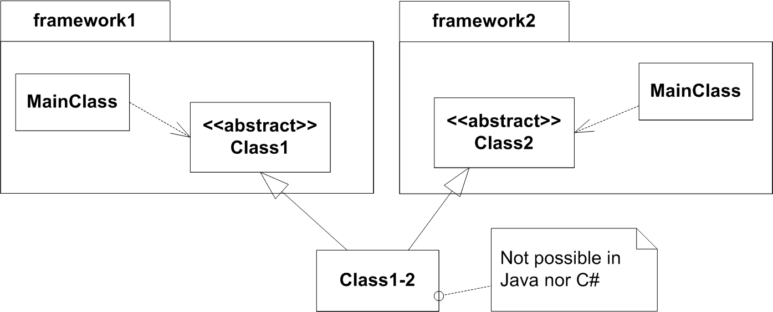
Mixing Two Frameworks
Based upon the inheritance based template method

Slide 51
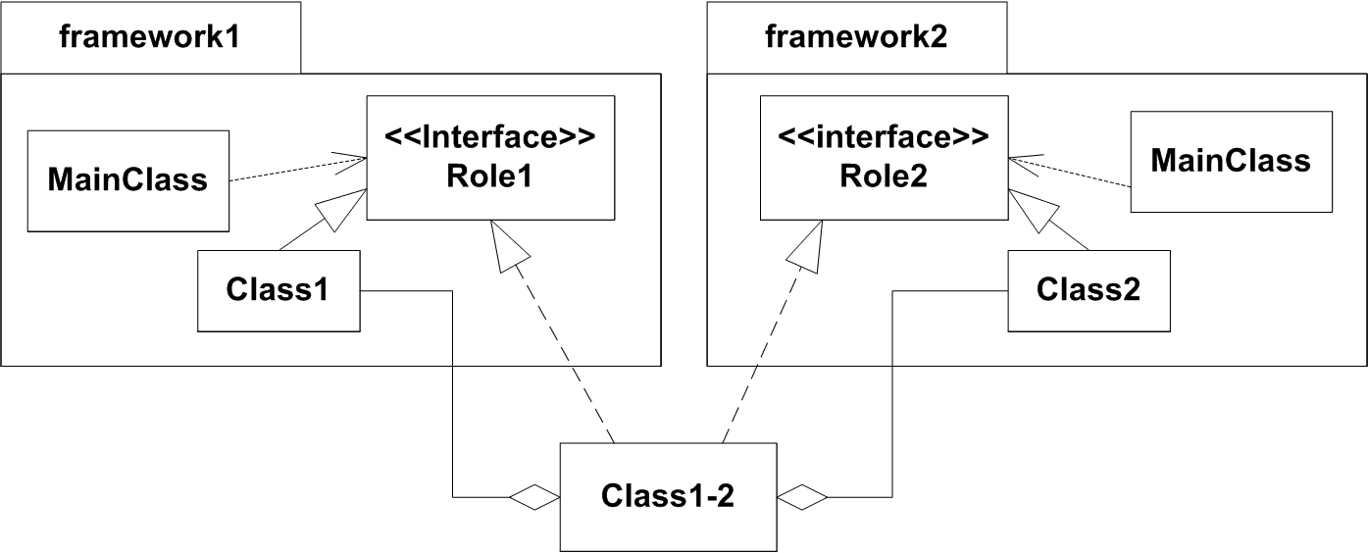
Mixing Two Frameworks
But it does work using compositional template method

Slide 52
Example: HotStone GUI
HotStone Domain
MiniDraw
<<i>>
GameObserver
<<i>>
Drawing
StandardFigureCollection
HotStoneDrawing
HotStoneDrawing implements Drawing, GameObserver

